Slide 1
20XC15 - Problem Solving and C Programming
Pointers

Slide 2
Outline
Introduction
Pointer Declaration and Initialization
Pointer Expressions and Pointer Arithmetic
Passing Arguments to Functions
Relationship between Pointers and Arrays
Pointers and Multidimensional Arrays
Pointers to Functions
Passing Functions to Other Functions
Dynamic Memory Allocation
Wild Pointer, Null Pointer
Dangling Pointer, void Pointer

Slide 3
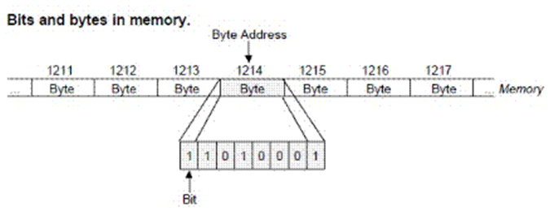
Computer Memory
RAM is the primary or main memory of computer
It is the place where the text, data, instructions and intermediate results are stored
The total memory is divided into number of bytes and each byte is again divided into 8 bits
These bits are actual places where the data is stored as 1’s and 0’s called binary data
Every byte is identified with a number called address
It is always a positive number because the first byte address is 0 and the last byte address is depends on the size of memory.

Slide 4
Variable
A variable is a name, set to a piece of memory in the RAM, which can be used to store and access the data
The value stored in the allocated (selected) memory may change as the program execution progresses so called variable
A variable may take one or more bytes of memory according to the data type we use while declaring the variable
Any variable of any type has three common characteristics, which are
  Name of the variable
  Value of the variable and
  The address of variable

Slide 5
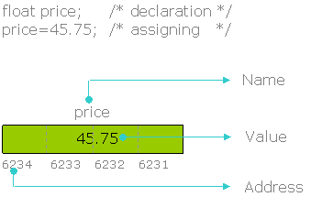
Variable
Name is the label of a variable (memory allocation) with which value can be assigned, modified and accessed
price=45.75; /* assigning a value */
price=price+10.50; /* modifying the value */
printf("%f",price); /* accessing and printing the value */
Note: Value is the data of any type stored in the memory in a binary format

Slide 6
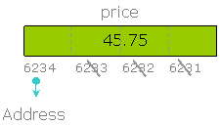
Address
The total memory is divided into number of bytes and each byte in the memory is identified with its serial number or byte number or we can call it as an address
It is always a positive number
According to the type, a variable may take one or more bytes of memory but, the first byte number or higher byte number is considered as the address of variable

Slide 7
How to get the address of a variable?
The address of any variable can be obtained using a unary operator called Address of operator &
Writing & operator as a prefix to the variable gives the address of variable
As the address of any variable is a positive number, the format specifier %u or %p or %x is used while printing the address
  %u prints the address in decimal
  %p and %x print the addresses in hexadecimal

Slide 8
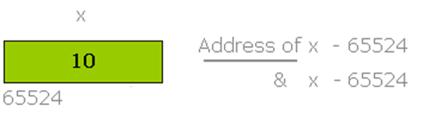
How to get the address of a variable?
Output :
Value 10
Address of x 65524
Address of x fff4
Address of x FFF4P
#include <stdio.h>
int main()
{
short x=10;
printf("Value %d",x); /* prints the value of x */
printf("\nAddress of x %u",&x); /* prints the address of x in decimal */
printf("\nAddress of x %x",&x); /* prints the address of x in hexadecimal */
printf("\nAddress of x %p",&x); /* prints the address of x in hexadecimal */
return 0;
}

Slide 9
Introduction to Pointers
A pointer is a variable that represents the location (rather than the value) of a data item
They have a number of useful applications
  Enables us to access a variable that is defined outside the function
  Can be used to pass information back and forth between a function and its reference point
  More efficient in handling data tables
  Reduces the length and complexity of a program
  Sometimes also increases the execution speed

Slide 10
Pointers
Since memory addresses are simply numbers, they can be assigned to some variables which can be stored in memory
  Such variables that hold memory addresses are called pointers.
  Since a pointer is a variable, its value is also stored in some memory location.
Consider the statement
  int xyz = 50;
Suppose we assign the address of xyz to a variable p
p = &xyz;
  p is said to point to the variable xyz
xyz ➔ variable
50 ➔ value
1380 ➔ address
Variable Value Address
xyz 50 1380
p 1380 2545
2545
1380
1380
50
p
xyz

Slide 11
Accessing the Address of a Variable
The address of a variable can be determined using the ‘&’ operator.
  The operator ‘&’ immediately preceding a variable returns the address of the variable
Example: p = &xyz;
  The address of xyz (1380) is assigned to p
The ‘&’ operator can be used only with a simple variable or an array element
  &distance
  &x[0]
  &x[i-2]
Following usages are illegal
  &235
    Pointing at constant
  &(a+b)
    Pointing at expression

Slide 12
Pointer Declarations
Pointer variables must be declared before we use them
Syntax
  data_type *pointer_name;
Three things are specified in the above declaration:
    The asterisk (*) tells that the variable pointer_name is a pointer variable
    pointer_name needs a memory location
    pointer_name points to a variable of type data_type
Example
  int *count;
  float *speed;
Once a pointer variable has been declared, it can be made to point to a variable using an assignment statement like
  int *p, xyz;
  :
  p = &xyz;

Slide 13



Assigning the address to the pointer
short *p;
It declares a short pointer to store the address of another short type of variable
short x=345;
It declares a short variable x and which is assigned with 345
p=&x;
Here the address of x is being assigned to the pointer. The value of p and the address of x are same (65522)

Slide 14
Example
#include <stdio.h>
int main()
{
short *p; /* declaration of short pointer */
short x=345; /* declaration of a short variable */
p=&x; /* assigning the address to the pointer */
printf("\nAddress of x %u",&x); /* address of x */
printf("\nAddress of x %u\n",p); /* address of x in pointer p */
return 0;
}
Execution:
Address of x 65522
Address of x 65522
Note: pointer initialization
short x= 345, *p=&x; //correct
short *p=&x, x=345; //incorrect

Slide 15
Things to Remember
Pointer variables must always point to a data item of the same type
  float x;
  int *p;
  : ➔ will result in erroneous output
  p = &x;
Assigning an absolute address to a pointer variable is prohibited
  int *count;
  :
  count = 1268;

Slide 16
Accessing a Variable Through its Pointer
Once a pointer has been assigned the address of a variable, the value of the variable can be accessed using the indirection operator (*)
  int a, b;
  int *p;
  :
  p = &a;
  b = *p;
Equivalent to
b = a

Slide 17
Example 1
#include <stdio.h>
main()
{
int a, b;
int c = 5;
int *p;
a = 4 * (c + 5) ;
p = &c;
b = 4 * (*p + 5) ;
printf (“a=%d b=%d \n”, a, b) ;
}
Equivalent

Slide 18
Example 2
#include <stdio.h>
main()
{
int x, y;
int *ptr;
x = 10 ;
ptr = &x ;
y = *ptr ;
printf (“%d is stored in location %u \n”, x, &x) ;
printf (“%d is stored in location %u \n”, *&x, &x) ;
printf (“%d is stored in location %u \n”, *ptr, ptr) ;
printf (“%d is stored in location %u \n”, y, &*ptr) ;
printf (“%u is stored in location %u \n”, ptr, &ptr) ;
printf (“%d is stored in location %u \n”, y, &y) ;
*ptr = 25;
printf (“\nNow x = %d \n”, x);
}

Slide 19
Example 2
Output:
10 is stored in location 3221224908
10 is stored in location 3221224908
10 is stored in location 3221224908
10 is stored in location 3221224908
3221224908 is stored in location 3221224900
10 is stored in location 3221224904
Now x = 25
Address of x: 3221224908
Address of y: 3221224904
Address of ptr: 3221224900

Slide 20
Pointer Expressions
Like other variables, pointer variables can be used in expressions.
If p1 and p2 are two pointers, the following statements are valid:
  sum = *p1 + *p2 ;
  prod = *p1 * *p2 ;
  prod = (*p1) * (*p2) ;
  *p1 = *p1 + 2;
  x = *p1 / *p2 + 5 ;

Slide 21
Pointer Expressions
What are allowed in C?
  Add an integer to a pointer.
  Subtract an integer from a pointer.
  Subtract one pointer from another (related).
If p1 and p2 are both pointers to the same array, them p2–p1 gives the number of elements between p1 and p2
What are not allowed?
  Add two pointers
    p1 = p1 + p2 ;
  Multiply / divide a pointer in an expression
  p1 = p2 / 5 ;
    p1 = p1 – p2 * 10 ;

Slide 22
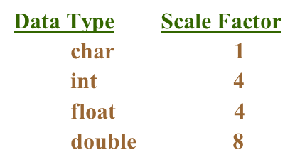
Scale Factor
We have seen that an integer value can be added to or subtracted from a pointer variable.
    int *p1, *p2 ;
    int i, j;
    :
    p1 = p1 + 1 ;
    p2 = p1 + j ;
    p2++ ;
    p2 = p2 – (i + j) ;
In reality, it is not the integer value which is added/subtracted, but rather the scale factor times the value
  If p1 is an integer pointer, then
  p1++
  will increment the value of p1 by 4.

Slide 23
Size of a pointer
The address of a memory allocation is a 16bit number in case of a 16bit system and 64bit in case of a 64bit system
Hence, the size of pointer must be the size of address because the purpose of pointer is to store the address
The size of any pointer of any type is the same that is, the sizes of char*, int*, float* and double* are same
#include <stdio.h>
int main()
{
short *p;
float *q;
double *r;
printf("Size of short pointer %d bytes",sizeof(p));
printf("\nSize of float pointer %d bytes",sizeof(q));
printf("\nSize of double pointer %d bytes",sizeof(r));
return 0;
}
Output in Turbo C:
Size of short pointer 2 bytes
Size of float pointer 2 bytes
Size of double pointer 2 bytes
Output in Linux gcc:
Size of short pointer 4 bytes
Size of float pointer 4 bytes
Size of double pointer 4 bytes

Slide 24
Size of a pointer
#include <stdio.h>
int main()
{
printf("Size of short pointer %d bytes",sizeof(short*));
printf("\nSize of float pointer %d bytes",sizeof(float*));
printf("\nSize of double pointer %d bytes",sizeof(double*));
return 0;
}
Output in Turbo C:
Size of short pointer 2 bytes
Size of float pointer 2 bytes
Size of double pointer 2 bytes
Output in Linux gcc:
Size of short pointer 4 bytes
Size of float pointer 4 bytes
Size of double pointer 4 bytes

Slide 25
Pointer to register variable
We can’t access the address of a register variable using address of operator &. Hence, we can’t create a pointer to the register variable
#include<stdio.h>
int main()
{
register short x=345;
short *p=&x;
printf("\nValue of x %d",x);
printf("\nAddress of x %u",&x);
return 0;
}
Output:
Error pointer1.c 5: Must take address of a memory location in function main
Error pointer1.c 7: Must take address of a memory location in function main

Slide 26
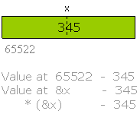
Pointers in action
It is also possible to access the data/value stored at a particular address in the memory indirectly using the value at operator *
For example, if the address of x is 65522 then we can access the value of x through its address using the value at operator *
#include <stdio.h>
int main()
{
short x=345;
printf("x=%d",x);
printf("\nx=%d\n",*(&x));
return 0;
}
Here 65522 is the address of x, which can be written as &x
Value at can be replaced with the operator * hence value at &x can be written as *(&x)
Output:
x=345
x=345

Slide 27
Summarizing value at operator *
* is the value at operator used to access the data indirectly through the address
It is a unary operator
It is also called indirection operator as it is used to access the data indirectly through the address
Accessing the data indirectly using indirection operator is called indirect reference or dereferencing

Slide 28

Possibility of confusion
* is being used in two places, that are while declaring a pointer and while accessing the value indirectly.
Though appears similarly, functionally both are different
If we use * while declaring a variable then it is to inform the compiler that it will be used to store the address of another variable
short *p;
The above statement informs the compiler that, p is a pointer variable will be used to store the address of another short type variable
If * operator is used in other places than the declaration statements then it is to perform indirect reference or dereference operation that is to access memory allocation through address or pointer
printf(“%d”, *p);

Slide 29
Possibility of confusion
printf("%d",*(&x));
It is to access and print the value at the address of x that is, value at 65522, which is 345
printf("%d",*p);
It is to access and print the value at p, that is value at 65522, which is 345
*p=400;
It is to assign value at p, that is value at 65522, which is the value of x
*p=*p+100;
It is modifying the value at p, that is value at 65522, which is the value of x

Slide 30
Example
#include <stdio.h>
int main()
{
short *p; /* declaration of pointer */
short x; /* declaration of variable */
p=&x; /* assigning the address to the pointer */
*p=400; /* assigning value to x through dereference */
printf("x=%d",*p); /* printing the value of x through dereference */
*p=*p+200; /* incrementing the value of x through dereference */
printf("\nx=%d\n",*p); /* printing the value of x through dereference */
return 0;
}
Output:
x=400
x=600

Slide 31
Example
#include<stdio.h>
int main()
{
int x=20,*p=&x;
x=x+40;
printf("\nx=%d",x);
*p=*p+30;
printf("\nx=%d",x);
return 0;
}
Output
x=60
x=90
Here the expression *p=*p+30; increments the value of x indirectly through the pointer

Slide 32
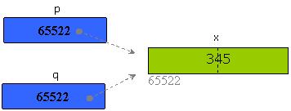
Multiple references to a common variable
Address of a variable can be stored in multiple pointers so that, any pointer can access the value of variable by dereferencing
int x=345, *p, *q;
p = &x;
q = &x
printf(“%d %d”, *p, *q);
(or)
int x=345, *p, *q;
p = &x;
q = p;
printf(“%d %d”, *p, *q);

Slide 33
Example
#include<stdio.h>
int main()
{
int x=20,y=40;
int *p=&x,*q=&y,*r;
r=p,p=q,q=r;
printf("%d",*p);
printf("\n%d",*q);
return 0;
}
Answer
40
20
Here p has the address of x and q has the address of y. The expression r=p, p=q, q=r; swaps the addresses. Now p points y and q points x, *p fetches the value of y and *q fetches the value of x

Slide 34
Example
Output:
x=12
y=11
y=*p; /* Assigns 1 to y */
*p=0; /* Assigns 0 to x */
*p=*p+10; /* Increments the value of x by 10 that x would be 10 */
y=*p+1; /* assigns 11 to y */
*p+=1; /* increments the value of x by 1 that would be 11 */
(*p)++; /* increments the value of x by 1 that would be 12 */
#include<stdio.h>
int main()
{
int x=1,y=2,*p=&x;
y=*p;
*p=0;
*p=*p+10;
y=*p+1;
*p+=1;
(*p)++;
printf("\nx=%d",x);
printf("\ny=%d\n",y);
return 0;
}

Slide 35
Practicing dereferencing
#include <stdio.h>
int main()
{
short x,y,z; /*declaration of variables */
short *p,*q,*r; /* declaration of pointers */
p=&x; /* assigning the addresses to the pointers */
q=&y;
r=&z;
printf("enter two integers:\n");
/* scanf("%d%d",&x,&y); */
scanf("%d%d",p,q); /* equal to &x and &y */
*r=*p+*q;
printf("Sum of two numbers %d",*r);
return 0;
}
Execution:
Enter two integers:
34
56
Sum of two numbers 90

Slide 36
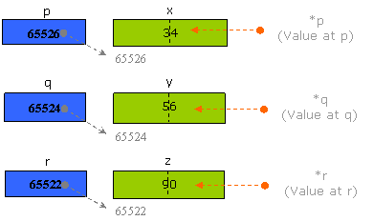
Example
Here p, q and r are the pointers to the variables x, y and z. By using the value at operator * we can access the values of x, y and z

Slide 37
Example
In the above program variables declaration, pointer declaration and pointer assigning statements are written as separate statements. We can minimize the code as
short x,y,z,*p,*q,*r;
p=&x;
q=&y;
r=&z;
Same code can be written as
short x,y,z,*p=&x,*q=&y,*r=&z;

Slide 38
Example
Accept the length, breadth of a rectangle and print the area, perimeter
#include <stdio.h>
int main()
{
short l,b,area,peri,*x=&l,*y=&b,*a=&area,*p=&peri;
printf("Length:");
/* scanf("%d",&l); */
scanf("%d",x);
printf("Breadth:");
/* scanf("%d",&b); */
scanf("%d",y);
*a=(*x)*(*y);
*p=2*(*x+*y);
printf("Area of rectangle %d",*a);
printf("\nPerimeter of rectangle %d",*p);
return 0;
}
Execution:
Length:25
Breadth:12
Area of rectangle 300
Perimeter of rectangle 74

Slide 39
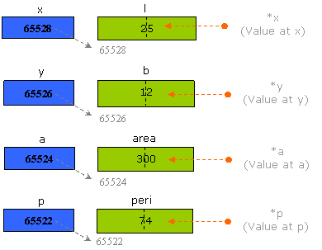
Example

Slide 40
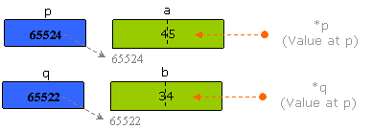
Example
Accept two numbers and print their values by interchanging them (Swapping)
#include <stdio.h>
int main()
{
short a,b,*p=&a,*q=&b;
printf("First number:");
/* scanf("%d",&a); */
scanf("%d",p);
printf("Second number:");
/* scanf("%d",&b); */
scanf("%d",q);
*p=*p+*q;
*q=*p-*q;
*p=*p-*q;
printf("First number %d",*p);
printf("\nSecond number %d",*q);
return 0;
}
Execution:
First number:34
Second number:45
First number 45
Second number 34

Slide 41
Passing Pointers to a Function
Pointers are often passed to a function as arguments
  Allows data items within the calling program to be accessed by the function, altered, and then returned to the calling program in altered form
  Call by address or by location
Normally, arguments are passed to a function by value
  The data items are copied to the function
  Changes are not reflected in the calling program

Slide 42
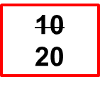
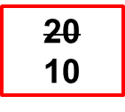
Example: passing arguments by value
#include<stdio.h>
void swap (int , int ); /*function prototype */
void main ()
{
int a, b;
printf (“\n Enter the values of a and b: “);
scanf (“%d%d”, &a, &b);
swap (a, b); /*function calling*/
printf (“\nFrom main The Values of a and b a=%d, b=%d “, a, b);
}
void swap (int x, int y) /* function definition */
{
int temp;
temp=x;
x=y;
y=temp;
printf (“\n The Values of a and b after swapping a=%d, b =%d”, x, y);
}
a b
10
20
11223 22446
x y
temp
10
77854 67531
88553

Slide 43


Example: passing arguments by address
void swap (int *px, int *py)
{
int temp;
temp = *px;
*px = *py;
*py = temp;
}
swap
px
py
temp
1024
9921
3
8894
2265
1137
int main ( )
{
int i = 3, j = 5;
swap(&i, &j) ;
printf (“%d,%d\n”,i,j);
return 0;
}
main
i
j
1024
9921
5,3

Slide 44
Pointers and Arrays
When an array is declared
  The compiler allocates a base address and sufficient amount of storage to contain all the elements of the array in contiguous memory locations
  The base address is the location of the first element (index 0) of the array
  The compiler also defines the array name as a constant pointer to the first element
Consider the declaration
  int x[5] = {1, 2, 3, 4, 5} ;
  Suppose that the base address of x is 2500, and each integer requires 4 bytes
  Element Value Address
  x[0] 1 2500
  x[1] 2 2504
  x[2] 3 2508
  x[3] 4 2512
  x[4] 5 2516

Slide 45
Pointers and Arrays
  x ⬄ &x[0] ⬄ 2500 ;
  p = x; and p = &x[0]; are equivalent.
  We can access successive values of x by using p++ or p- - to move from one element to another
Relationship between p and x
    p = &x[0] = 2500 *(p+0) = x[0] =>1
    p+1 = &x[1] = 2504 *(p+1) = x[1] =>2
    p+2 = &x[2] = 2508 *(p+2) = x[2] =>3
    p+3 = &x[3] = 2512 *(p+3) = x[3] =>4
    p+4 = &x[4] = 2516 *(p+4) = x[4] =>5
int x[5] = {1, 2, 3, 4, 5} ;
*(p+i) gives the value of x[i]
x
1 | 2 | 3 | 4 | 5
p
.

Slide 46
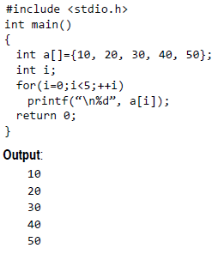
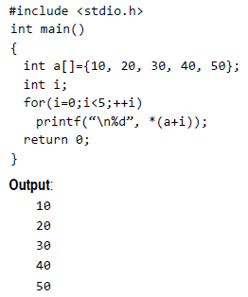

Pointers and Arrays

Slide 47
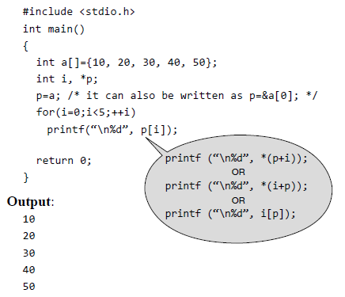
Pointers and Arrays

Slide 48
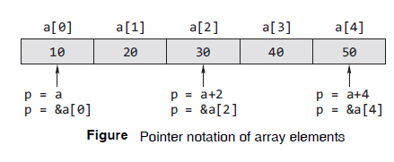
Pointers and Arrays
int a[ ]={10,20,30,40,50};
int *p = a; (or) int *p = &a; (or) int *p = &a[0];

Slide 49
Example: function to find average
int *array
#include <stdio.h>
main()
{
int x[100], k, n ;
scanf (“%d”, &n) ;
for (k=0; k<n; k++)
scanf (“%d”, &x[k]) ;
printf (“\nAverage is %f”,
avg (x, n));
}
float avg (int array[ ], int size)
{
int *p, i , sum = 0;
p = array ;
for (i=0; i<size; i++)
sum = sum + *(p+i);
return ((float) sum / size);
}

Slide 50
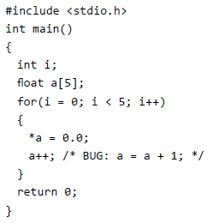
Differences between Array name and Pointer
When memory is allocated for the array, the starting address is fixed, i.e., it cannot be changed during program execution
Therefore, array name is an address constant; the value contained in it should not be changed

Slide 51
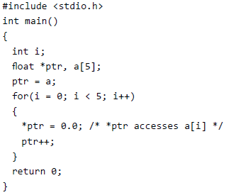
Differences between Array name and Pointer
A pointer variable can be declared, which can point to the same type as the type of the array, and initialize it with the base address of array
This pointer variable can be used as an lvalue and no error message will be displayed

Slide 52
Differences between Array name and Pointer
An array cannot be assigned to another
int a[5]={1,2,3,4,5};
int b[5];
b = a; /* WRONG */
Correct
for(i=0; i<5; i++) (or) for(i=0; i<5; b[i]=a[i], i++);
b[i]=a[i];
Two pointer variables can be assigned
int *p1, *p2;
int a[10]={1,2,3,4,5};
p1 = &a[0];
p2 = p1;

Slide 53
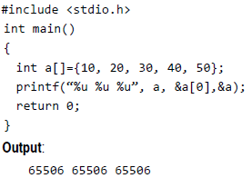
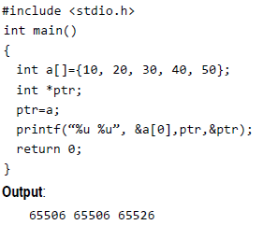
Differences between Array name and Pointer
The & (address of) operator normally returns the address of the operand
Arrays are the exception. When applied to an array (which is an address), it has the same value as the array reference without the operator
This is not true of the equivalent pointers, which have an independent address

Slide 54
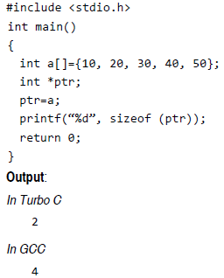
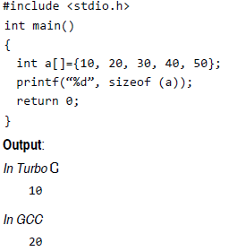
Differences between Array name and Pointer
The sizeof operator returns the size of the allocated space for arrays. In case of a pointer, the sizeof operator returns two or four or more bytes of storage (machine dependent)

Slide 55
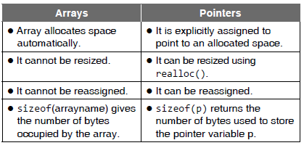
Differences between Array name and Pointer

Slide 56
Pointers and Multidimensional Arrays
A multidimensional array can also be represented with an equivalent pointer notation
A two-dimensional array is actually a collection of one-dimensional arrays
We can define a two-dimensional array as a pointer to a group of contiguous one-dimensional arrays
Thus, a two-dimensional array declaration can be written as
data- type (*ptvar) [ expression 2] ;
rather than
data- type array[ expression 1] [ expression 2];
This concept can be generalized to higher-dimensional arrays, ie.,
data- type ( *ptvar)[ expression 2] [ expression 3]... [ expression n] ;
replaces
data- type array[ expression 1][ expression 2]...[ expression n] ;

Slide 57
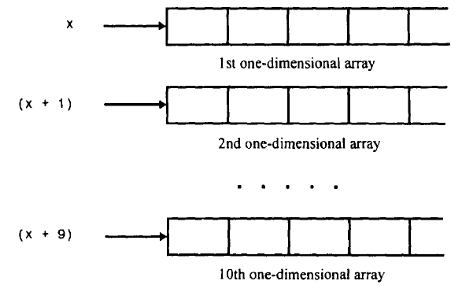
Pointers and Multidimensional Arrays
x is a two-dimensional integer array having 10 rows and 20 columns can be declared as
int (*x)[20];
rather than int x[10][20];
int (*x)[20]; - x is defined to be a pointer to a group of contiguous, one-dimensional, 20-element integer arrays
  x points to the first 20-element array, which is actually the first row (i.e., row 0) of the original two-dimensional array.
  Similarly, ( x + 1) points to the second 20-element array, which is the second row (row 1) of the original two-dimensional array

Slide 58
Pointers and Multidimensional Arrays
The item in row 2, column 5 can be accessed by writing either
x[2][5]
(or)
* ( * ( x+2) + 5)
(x + 2) - is a pointer to row 2
* ( x + 2) - a pointer to the first element in row 2
(* (x + 2) + 5) is a pointer to element 5 (i.e., the 6th element) in row 2
* ( * (x + 2) + 5),therefore refers to the item in column 5 of row 2, which is x [2] [5]

Slide 59
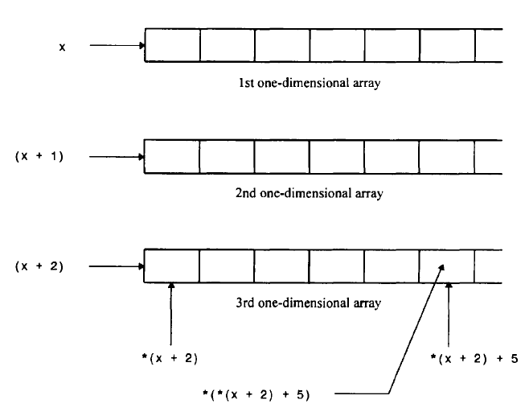
Pointers and Multidimensional Arrays

Slide 60
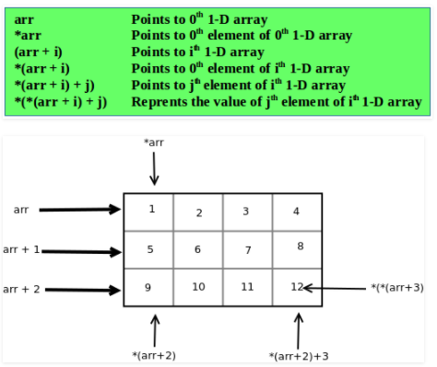
Pointers and Multidimensional Arrays

Slide 61
Pointers and Multidimensional Arrays
#include <stdio.h>
#define ROWS 3
#define COLS 3
/* Function declaration to input and print two dimensional array */
void inputMatrix(int matrix[][COLS], int rows, int cols);
void printMatrix(int matrix[][COLS], int rows, int cols);
int main()
{
int matrix[ROWS][COLS];
int i, j;
/* Input elements in matrix */
printf("Enter elements in %dx%d matrix.\n", ROWS, COLS);
inputMatrix(matrix, ROWS, COLS);
/* Print elements in matrix */
printf("Elements of %dx%d matrix.\n", ROWS, COLS);
printMatrix(matrix, ROWS, COLS);
return 0;
}

Slide 62
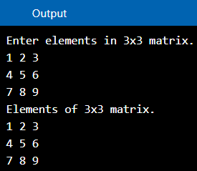
Pointers and Multidimensional Arrays
void inputMatrix(int matrix[ ][COLS], int rows, int cols)
{ int i, j;
for(i = 0; i < rows; i++)
{ for(j = 0; j < cols; j++)
{ // (*(matrix + i) + j is equivalent to &matrix[i][j]
scanf("%d", (*(matrix + i) + j));
}
}
}
void printMatrix(int (*matrix)[COLS], int rows, int cols)
{ int i, j;
for (i = 0; i < rows; i++)
{ for (j = 0; j < cols; j++)
{ // *(*(matrix + i) + j) is equivalent to matrix[i][j]
printf("%d ", *(*(matrix + i) + j));
}
printf("\n");
}
}

Slide 63
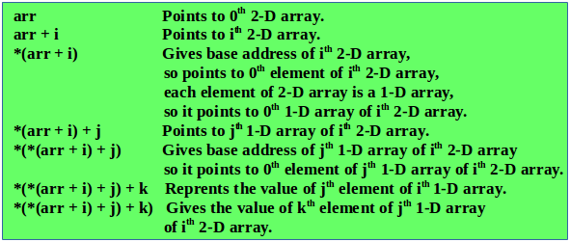
Pointers and Multidimensional Arrays
Consider a three-dimensional floating-point array t.
This array can be defined as
float (*t)[20][30];
rather than
float t[10][20][30];

Slide 64
Pointers and Multidimensional Arrays
A multidimensional array can be expressed in terms of an array of pointers rather than a pointer to a group of contiguous arrays
A two-dimensional array can be defined as a one-dimensional array of pointers by writing
data - type *array[ expression 1] ;
rather than the conventional array definition,
data- type array[ expression 1] [ expression 2] ;
Similarly, an n-dimensional array can be defined as an (n-1) -dimensional array of pointers by writing
data- type *array[ expression 1] [ expression 2]...[ expression n-1] ;
rather than
data- type array[ expression 1] [ expression 2]...[ expression n];

Slide 65
Pointers and Multidimensional Arrays
When an n-dimensional array is expressed as array of pointers, an individual array element within the n-dimensional array can be accessed by a single use of the indirection operator
Suppose x is a two-dimensional integer array having 10 rows and 20 columns
We can define x as a one-dimensional array of pointers by writing
int *x [10] ;
x[0] points to the beginning of the first row
x[1] points to the beginning of the second row, and
so on
Note : The number of elements within each row is not explicitly specified

Slide 66
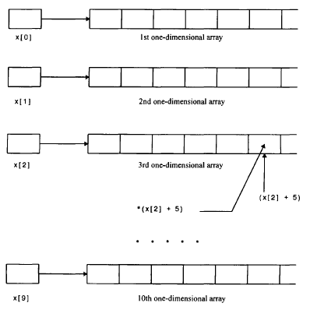
Pointers and Multidimensional Arrays

Slide 67
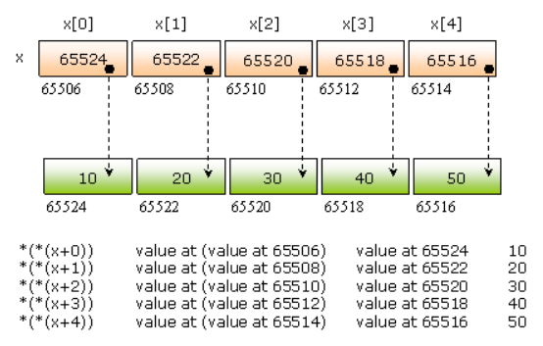
Pointers and Multidimensional Arrays
short a=10,b=20,c=30,d=40,e=50;
short *x[5];
x[0]=&a; x[1]=&b; x[2]=&c; x[3]=&d; x[4]=&e;

Slide 68
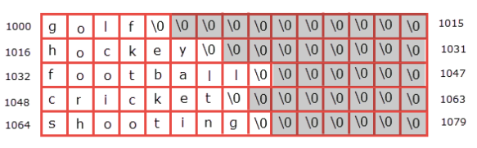
Pointers and Multidimensional Arrays
Array of Pointers to Strings
An array of pointers to strings is an array of character pointers where each pointer points to the first character of the string or the base address of the string
char sports[5][15] = {
"golf",
"hockey",
"football",
"cricket",
"shooting"
};

Slide 69
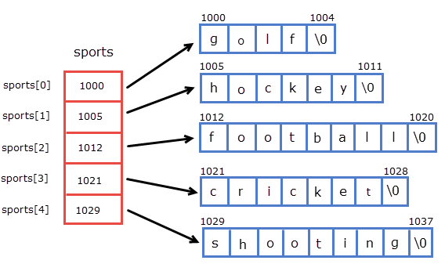
Pointers and Multidimensional Arrays
char *sports[5] = {
"golf",
"hockey",
"football",
"cricket",
"shooting"
};
char *sports[ ] = {
"golf",
"hockey",
"football",
"cricket",
"shooting"
};

Slide 70
Pointer to a function
Like a variable or an array even a function is stored some where in the memory, has its address.
The name of the function gives the address of that function
#include<stdio.h>
void display()
{
printf("Hello World");
}
int main()
{
printf("%u",display);
return 0;
}
Output
4199248

Slide 71
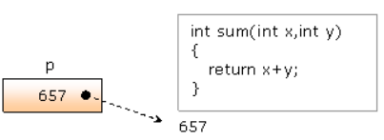
Pointer to a Function
Since the name of function gives the address, a pointer can be created to the function
Where the type of pointer must be of function type (return type) and the list of argument types must be specified with the declaration
int sum(int x,int y)
{
return x+y;
}
is
int *p(int,int);
But, the compiler gives error as p(int,int) evaluates before identifying p as a pointer because () has higher priority than *
Hence, we need to give explicit priority to *p by placing it within ()
int (*p)(int,int); /* declaration of pointer */ p=sum; /* assigning the address */

Slide 72
Pointer to a Function
We can call the function through the pointer using dereferencing
s=(*p)(10,20);
#include<stdio.h>
int sum(int x,int y)
{
return x+y;
}
int main()
{
int s;
int (*p)(int,int); /* declaring pointer to function */
p=sum; /* assigning address of a function to the pointer */
s=(*p)(30,40); /* accessing function through dereferencing */
printf("Sum of two numbers %d", s);
return 0;
}
Output:
Sum of two numbers 70

Slide 73
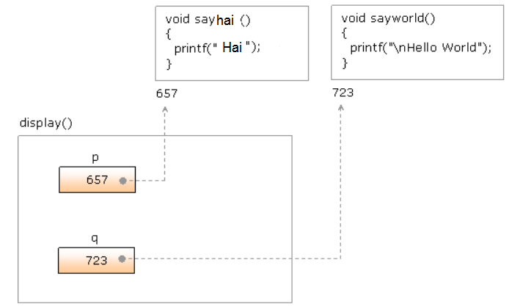
Sending the address of a function as Argument
#include<stdio.h>
void sayhai()
{
printf(“Hai");
}
void sayworld()
{
printf("\nHello World");
}
void display(void (*p)(),void (*q)())
{ (*p)();
(*q)();
}
int main()
{
display(sayhai, sayworld);
return 0;
}
Output:
Hai
Hello World

Slide 74
Sending the Address of a Function as Argument
Accept two integers and print the sum, subtraction using two functions getsum(), getsub() and sending these into other function display() as arguments
int main()
{
manip(getsum,getsub);
return 0;
}
Output
Enter two numbers:
12
6
Sum 18
Subtraction 6
#include<stdio.h>
int getsum(int x,int y)
{ return x+y; }
int getsub(int x,int y)
{ return x-y; }
void manip(int (*p)(int,int),int (*q)(int,int))
{
int a,b,c,d;
printf("Enter two numbers:\n");
scanf("%d%d",&a,&b);
c=(*p)(a,b);
d=(*q)(a,b);
printf("Sum %d",c);
printf("\nSubtaction %d",d);
}

Slide 75
Pointer Array to Functions
Array of pointers can be defined to store the addresses of different functions. So that, functions can be called in a sequence
#include<stdio.h>
void one()
{
printf("Keep it ");
}
void two()
{
printf("small ");
}
void three()
{
printf("and simple");
}
int main()
{
void (*p[3])();
int i;
p[0]=one;
p[1]=two;
p[2]=three;
/*
for(i=0;i<3;i++)
(*(p[i]))();
*/
for(i=0;i<3;i++)
(*(*(p+i)))();
return 0;
}
Output: Keep it small and simple

Slide 76
Constant Pointer
Constant pointer is a pointer variable whose value cannot be altered throughout the program
It does not allows modification of its value, however you can modify the value pointed by a pointer
Syntax
  <pointer-type> * const <pointer-name> = <memory-address>;
Example
  int num;
  int * const constant_pointer = &num;
The compiler will generate compilation error on failure of any of the two conditions.
We must initialize a constant pointer during its declaration
A constant pointer must not be re-assigned

Slide 77
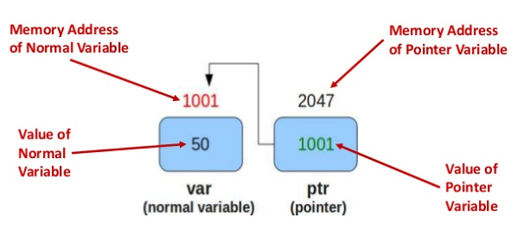
Constant Pointer
int var = 50, var2=100;
int *const ptr= &var;
ptr = &var2; //error
*ptr = 1000; // correct

Slide 78
Pointer to Constant
Pointer to constant is a pointer that restricts modification of value pointed by the pointer
We can modify pointer value, but you cannot modify the value pointed by pointer
Syntax
  const <pointer-type> * <pointer-name>;
Example
  int num = 10;
  const int * ptr = &num;
Note: There is a minor difference between constant pointer and pointer to constant
A constant pointer can only point to single object throughout the program We can alter the value pointed by pointer, but cannot alter pointer value
Whereas pointer to a constant cannot modify the value pointed by pointer, but can alter its value

Slide 79
Pointer to a Constant
int var = 50, var2=100;
const int *ptr= &var;
*ptr = 1000; //error
ptr = &var2;
var=2000 //correct
Read only value
Cannot be changed using ptr

Slide 80
Constant Pointer to Constant
A constant pointer to constant is a combination of constant pointer and pointer to constant
It is a pointer that does not allow modification of pointer value as well as value pointed by the pointer
Syntax
  const <pointer-type> * const <pointer-name> = <memory-address>;
Example
  int num = 10;
  const int * const ptr = &num;

Slide 81
Constant Pointer to Constant
int var = 50, var2=100;
const int *const ptr= &var;
ptr = &var2; //error
*ptr = 1000; // error
var = 2000; //correct

Slide 82
Dynamic Memory Allocation
Need of dynamic or run-time memory allocation
The memory allocation of any variable, array or pointer is planned during the compilation of the program
There are some limitations with compile time memory allocation
  Allocated objects would be de-allocated only on completion of function execution in which objects are declared. We can’t de-allocate the objects when we don’t want them any more.
  We need to specify the size of array while writing the code, out of which only a few elements may be used during the execution of program. It results wastage of memory because allocated memory can’t be expanded or compressed

Slide 83
Dynamic Memory Allocation
Allocating and de-allocating memory during the execution of program (runtime) is called dynamic or runtime memory allocation
The functions used for dynamic memory allocation are
  malloc()
  realloc()
  calloc()
  free()
Include stdlib.h header file to use these functions

Slide 84
Dynamic Memory Allocation
malloc()
Requests a contiguous block of memory of the given size in the heap. It returns a pointer to the heap block or NULL if the request is not satisfied
The block pointer returned by malloc() is a void * (i.e., it makes no claim about the type of its pointee), a cast will probably be required when storing the void pointer into a regular typed pointer
Syntax
  ptr = (cast-type*) malloc(byte-size);
Example
int N = 10; // Number of bytes to allocate
int *ptr; // Pointer variable to store address
ptr = (int *) malloc(N * sizeof(int));
// Allocate 10 * 4 bytes in memory

Slide 85
Dynamic Memory Allocation
free()
The memory allocated using functions malloc() and calloc() is not de-allocated on their own
Hence, the free() method is used, whenever the dynamic memory allocation takes place. It helps to reduce wastage of memory by freeing it
free() takes a pointer to a heap block earlier allocated by malloc() and returns that block to the heap for reuse
Syntax
  void free(void* block);

Slide 86
Dynamic Memory Allocation
How does free() know the size of memory to be deallocated?
Consider the following prototype of free() function which is used to free memory allocated using malloc() or calloc() or realloc().
void free(void *ptr);
Note that the free function does not accept size as a parameter. How does free() function know how much memory to free given just a pointer?
Following is the most common way to store size of memory so that free() knows the size of memory to be deallocated
When memory allocation is done, the actual heap space allocated is one word larger than the requested memory. The extra word is used to store the size of the allocation and is later used by free( )

Slide 87
Dynamic Memory Allocation
#include<stdio.h>
int main()
{
int *p,*q,*r;
p=(int*)malloc(sizeof(int));
q=(int*)malloc(sizeof(int));
r=(int*)malloc(sizeof(int));
printf("Enter two integers:\n");
scanf("%d%d", p, q); /* p,q holds the addresses of allocated memory */
*r=*p+*q;
printf("Sum of two numbers %d",*r);
free(p);
free(q);
free(r);
return 0;
}

Slide 88
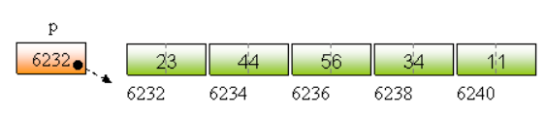
Dynamic Memory Allocation
#include<stdio.h>
int main()
{
short n,i,sum,*p;
printf("How many elements?");
scanf("%d",&n);
/* allocating memory allocation of n elements */
p=(short*) malloc(sizeof(short)*n);
printf("Enter %d elements:\n",n);
for(i=0;i<n;i++)
scanf("%d",p+i);
for(sum=0,i=0;i<n;i++)
sum=sum+*(p+i);
printf("Sum of all the elements %d",sum);
free(p);
return 0;
}

Slide 89
Dynamic Memory Allocation
calloc()
It allocates memory contiguously. It allocates multiple memory blocks and initializes all blocks with 0
Note: malloc() allocates uninitialized memory blocks
Syntax
void * calloc(size_t count, size_t eltsize);
This function allocates a block long enough to contain an array of count elements, each of size eltsize. Its contents are cleared to zero before calloc returns
If sufficient memory is not available, the malloc()and calloc() returns a NULL
Note: calloc() initializes all the bits in the allocated space set to zero where as malloc() does not do this. A call to calloc() is equivalent to a call to malloc() followed by one to memset()
calloc(m, n) is equivalent to p = malloc(m * n); memset(p, 0, m * n);

Slide 90
Dynamic Memory Allocation
#include <stdio.h>
#include <stdlib.h>
int main()
{ int N,*a, i, s=0;
printf(“\n enter the number of elements of the array:”);
scanf(“%d”,&N);
a=(int *) calloc(N, sizeof(int));
if(a==NULL)
{
printf(“\n memory allocation unsuccessful...”);
exit(0);
}
printf(“\n enter the array elements one by one”);
for(i=0; i<N;++i)
{ scanf(“%d”,(a+i));
s+=a[i];
}
printf(“\n sum is %d ”,s);
return 0;
}

Slide 91
Dynamic Memory Allocation
realloc()
Takes an existing heap block and try to reallocate it to a heap block of the given size which may be larger or smaller than the original size of the block
It returns a pointer to the new block, or NULL if the reallocation was unsuccessful
short *p,*q;
p=(short*)malloc(2);
allocates two bytes of memory, the address of which assigns to the pointer p
*p=540; // allocated memory is assigning with 540
q=(short*)realloc(p,4);
Allocates 6 bytes of memory that is 2 bytes to store the data belongs to p and 4 bytes of extending memory

Slide 92
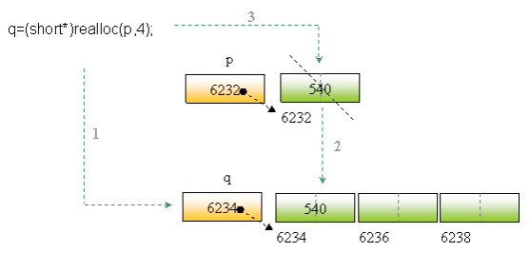
Dynamic Memory Allocation
p=(short*)malloc(2);
1. Allocates the new memory
2. Copy the contents of existed memory into new memory
3. De-allocates the old memory

Slide 93
Dynamic Memory Allocation
printf("How many more?");
scanf("%d",&m);
q=(short*)realloc(p,sizeof(short)*m);
for(i=n;i<n+m;i++)
scanf("%d",q+i);
printf("Total elements:\n");
for(i=0;i<n+m;i++)
printf("%5d",*(q+i));
free(q);
return 0;
}
#include<stdio.h>
int main()
{
short *p,*q;
short i,n,m;
printf("How many elements?");
scanf("%d",&n);
printf("Enter %d elements:\n",n);
p=(short*)malloc(sizeof(short)*n);
for(i=0;i<n;i++)
scanf("%d",p+i);
Execution:
How many elements?3
Enter 3 elements:
12 34 56
How many more?5
Enter 5 elements:
22 33 44 56 77
Total elements:
12 34 56 22 33 44 56 77

Slide 94
Memory Leakage
What happens when some memory is allocated in the heap using dynamic memory allocation, but has not de-allocated?
The result would be that the heap gradually fills up as there would be continuous request to allocate, but no de-allocation requests to return free memory to re-use
A program which forgets to de-allocate dynamically allocated memory is said to have a “memory leak”
Possibilities of memory leak – Case 1
  a pointer is stored in the stack segment and dynamically allocated memory is allocated in the heap segment
  Pointer has a scope like any other variable but, dynamically allocated memory has no scope and only de-allocated on completion of program execution
void allocate(int n)
{
int *p;
p=(int*)malloc(sizeof(int)*n);
}

Slide 95
Memory Leakage
Possibilities of memory leak – Case 2
It may result memory leak when allocates for multiple times and points with the same pointer
The address returned from the second allocation overwrites the address of the first allocation. Consequently, the first allocation becomes a memory leak
int *p;
p=(int*)malloc(10);
p=(int*)malloc(20);

Slide 96
Memory Leakage
Possibilities of memory leak – Case 3
Some times copying pointers may leads to memory leakage
Both p and q points different memory locations, address of second allocation is copied into p
Now both p and q points the second allocation. Consequently, first allocation becomes a memory leak
Note : The best way to get rid from this problem is de-allocating allocated memory using free() when we don’t need any more
int *p,*q;
p=(int*)malloc(10);
q=(int*)malloc(10);
p=q;

Slide 97
Wild Pointer
A pointer which is not initialized with any address is called wild pointer
The wild pointer is by default stored with the garbage value
#include<stdio.h>
int main() {
short *p;
printf("%u", p);
return 0;
}
Note : NULL pointer is assigned with the address 0 where as wild pointer is not assigned with any address

Slide 98
NULL Pointer
NULL pointer is a pointer which is set to address 0
The actual meaning of null pointer is that it is not pointing to anything
It is good practice of assigning a pointer with NULL both when the pointer is declared and de-allocated
Example
#include<stdio.h>
int main()
{
short *p=NULL;
if(!p)
p=(short*)malloc(sizeof(short));
*p=45;
printf("%d",*p);
free(p);
p=NULL;
return 0;
}

Slide 99
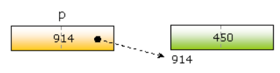

Dangling pointer
short *p; p=(short*)malloc(2);
Here, p points the memory allocation allocated by malloc()
free(p);
Though we delete the allocated memory, p still points the same memory
If a pointer points de-allocated memory then the pointer is called dangling pointer

Slide 100
Dangling pointer
#include<stdio.h>
int* test()
{
int a=10;
return &a;
}
int main()
{
int *p;
p=test();
}
The scope of variable a of test() ends after returning the address to main(). Now p points a memory location which has de-allocated
So, here p is the dangling pointer

Slide 101
Dangling pointer
The scope of x ends once the control comes out of if conditional statement
Now p would be a dangling pointer as it is still pointing de-allocated memory
#include<stdio.h>
int main()
{
int *p;
if(1)
{
int x=10;
p=&x;
printf("%d",*p);
}
}

Slide 102
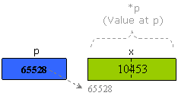
Type of pointer and void pointer
While accessing the data through dereference (through pointer using value at * operator), the type of pointer decides up to how many bytes the data must read
For example :
  if the pointer is of short type then the data will read from adjacent two bytes
  if the pointer is of float type then the data will read from adjacent four bytes and
  if the pointer is of char type then the data will read from first one byte
short x=10453,*p=&x;
printf("%d",*p);
Here the pointer p reads the data from adjacent two bytes from the first byte because short type takes two bytes

Slide 103
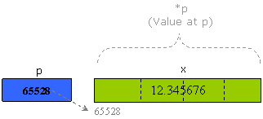
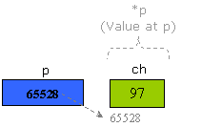
Type of pointer and void pointer
float x=12.345676,*p=&x;
printf("%f",*p);
Pointer p reads the data from adjacent four bytes from the first byte because float type takes four bytes
char ch='a',*p=&ch;
printf("%c",*p);
Here. pointer p reads the data from only one byte because the char type takes only one byte.

Slide 104
Type of pointer and void pointer
What happens when we store the address of one type of variable into another type of pointer?
#include<stdio.h>
int main()
{
short x=13457;
char *p=&x;
printf("\n%d",*p);
printf("\n%d",*(p+1));
return 0;
}
Output
-111
52

Slide 105
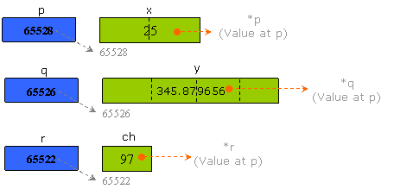
void pointer
A generic pointer to store the address of any type of variable but, can’t access the value of variable using dereferencing because the void pointer doesn’t know what type of objects it is pointing to
We need to typecast void pointer type to variable pointer type before performing indirection or dereferencing
short x=25;
float y=345.879656;
char ch='a';
void *p=&x; /* pointing short type object */
void *q=&y; /* pointing float type object */
void *r=&ch; /* pointing char type object */

Slide 106
void pointer - Example
#include<stdio.h>
int main()
{
short x=25;
float y=345.879656;
char ch='a';
void *p=&x,*q=&y,*r=&ch;
printf("\nProgram successfully executed..");
return 0;
}
Execution:
Program successfully executed..

Slide 107
void pointer - Example
#include<stdio.h>
int main()
{
short x=25;
float y=345.879656;
char ch='a';
void *p=&x,*q=&y,*r=&ch;
printf("x=%d",*p);
printf("\ny=%f",*q);
printf("\nz=%c",*r);
return 0;
}
Execution:
Error pointer1.c 8: Not an allowed type in function main
Error pointer1.c 9: Not an allowed type in function main
Error pointer1.c 10: Not an allowed type in function main

Slide 108
void pointer - Example
To rectify the problem of accessing the values of variables through void pointers using dereference, we need to typecast void pointer to variable type pointers to access the values of variables using dereference
#include<stdio.h>
int main()
{
short x=25;
float y=345.879656;
char ch='a';
void *p=&x,*q=&y,*r=&ch;
printf("x=%d",*((short*)p)); /* type casting to short* */
printf("\ny=%f",*((float*)q)); /* type casting to float* */
printf("\nz=%c",*((char*)r)); /* type casting to char* */
return 0;
}
Execution:
x=25
y=345.879669
z=a

Slide 109
Size of void pointer
Though the size of void type is 0, the size of void pointer is the same size as any other pointer type
#include<stdio.h>
int main()
{
printf("\nSize of void pointer %d",sizeof(void*));
return 0;
}
Output
Size of void pointer 4

Slide 110

Pointers to Pointers
C allows the use of pointers that point to pointers, and these, in turn, point to data.
For pointers to do that, we only need to add an asterisk (*) for each level of reference
Consider the following declaration.
int a=5;
int *p; //pointer to an integer
int **q; // pointer to a pointer to an integer
p=&a;
q=&p;
To refer to a using pointer p, dereference it once, that is, *p
To refer to a using q, dereference it twice because there are two levels of indirection involved

Slide 111

Pointers to Pointers
#include <stdio.h>
int main()
{
int a=5;
int *p,**q;
p=&a;
q=&p;
printf(“\n *p=%d”,*p);
printf(“\n **q=%d”,**q);
return 0;
}
Output
*p=5
**q=5

Slide 112
Pointer Arithmetic
Valid operations on pointers
(i) Assignment of pointers to the same type of pointers: the assignment of pointers is done symbolically
Hence, no integer constant except 0 can be assigned to a pointer
#include <stdio.h>
int main()
{
int i=5;
int *ip;
void *vp;
ip = &i;
vp = ip;
printf(“\n *vp= %d”,*((int *)vp));
ip = vp;
printf(“\n *ip= %d”,*ip);
return 0;
}
int *p;
p = NULL;
It is also possible to refer to the
null pointer by using a constant 0
by simply writing
int *ip = 0;
In fact, NULL is a preprocessor
macro that typically has the value, 0
Output:
*vp=5
*ip=5

Slide 113
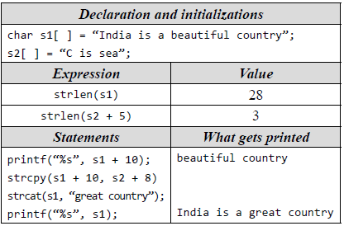
Pointer Arithmetic
(ii) Addition or Subtraction with Integers
If p is a pointer to an element in an array, then (p+1) points to the next element in the array
The statement p++ (or) ++p can be used to step a pointer over the elements in an array
#include <stdio.h>
int main(void)
{
int a[ ] = {10, 12, 6, 7, 2};
int i;
int sum = 0;
int *p;
p = a;
for(i=0; i<5; i++)
{
sum += *p;
p++; //++p;
}
printf(“%d\n”, sum); }

Slide 114
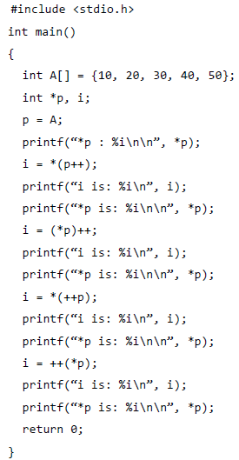
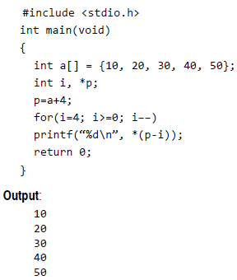
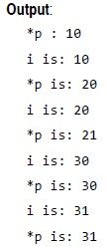
Pointer Arithmetic

Slide 115
Pointer Arithmetic
(iii) Subtraction of Pointers
An integer can be added to a pointer to get a new pointer, pointing somewhere beyond the original (as long as it is in the same array)
Example : If both p1 and p2 are pointers pointing to the elements of the same array
#include <stdio.h>
int main()
{
double a[5], *p, *q;
p=a;
q=p+4;
printf("%d\n", q - p);
return 0;
}
Output
4
#include <stdio.h>
int main()
{
double a[5],*p,*q;
p=a;
q=p+4;
printf("%d\n",(int) q - (int) p);
return 0;
}
Output
32

Slide 116
Pointer Arithmetic
(iv) Comparing Pointers
C allows pointers to be compared with each other. If two pointers compare equal to each other, then they point to the same thing
The relational operators >, <=, and so on give the result that would be expected if the pointers point to the same array
#include <stdio.h>
int main(void)
{
int a[ ] = {10, 20, 30, 40, 50};
int i, *p;
for(p=a; p<=a+4; p++)
printf(“%d\n”, *p);
return 0;
}
Output:
10
20
30
40
50

Slide 117
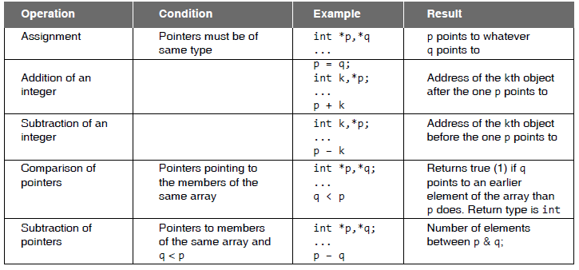
Pointer Arithmetic Summary

Slide 118
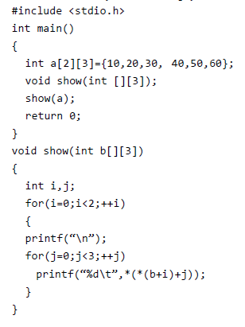
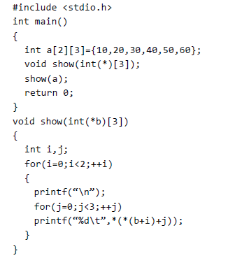
Passing 2D Arrays to Functions

Slide 119
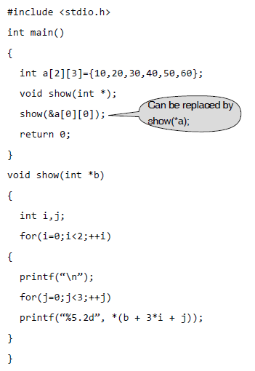

Passing 2D Arrays to Functions

